Slide 1


CSYE 7374: Design Patterns

Slide 2
TECHNOLOGIES USED:
Front End – Java FX
Database : FXML Data – CSV File
Backend – JavaEE

Slide 3

Implemented Design Patterns
Singleton – To get model objects instantiated
Adapter Pattern
Command Pattern
Decorator pattern
Façade pattern
Factory Pattern
Prototype pattern
State Pattern
Strategy Pattern

Slide 4
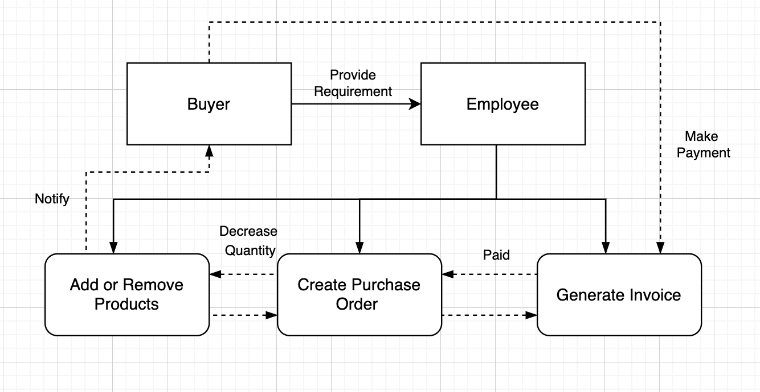
Flow of STORE Management

Slide 5
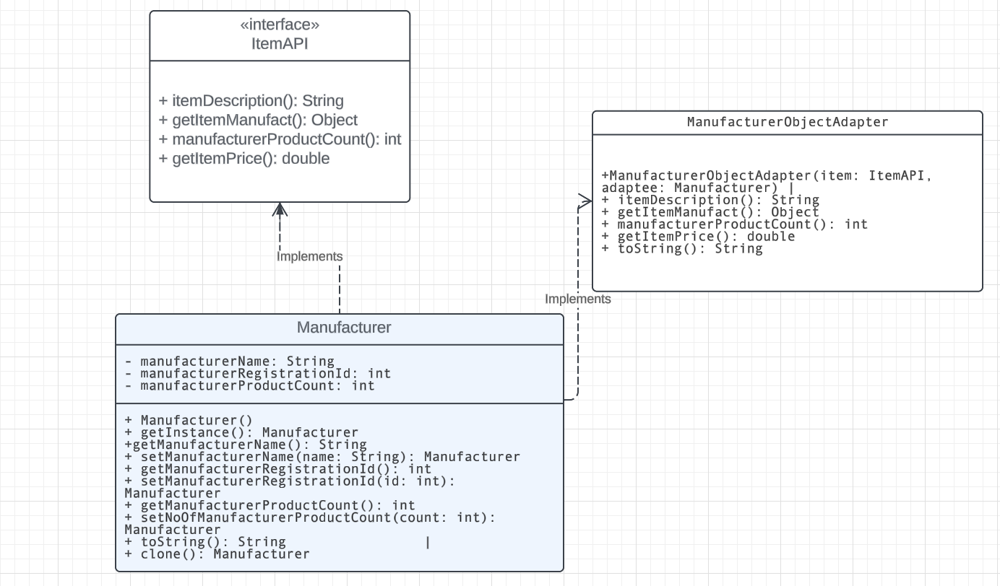
UML – ADAPTER Pattern
Decorator Pattern provides a way to access manufacturer details through the methods specified in the ItemAPI interface, facilitating compatibility between the two

Slide 6
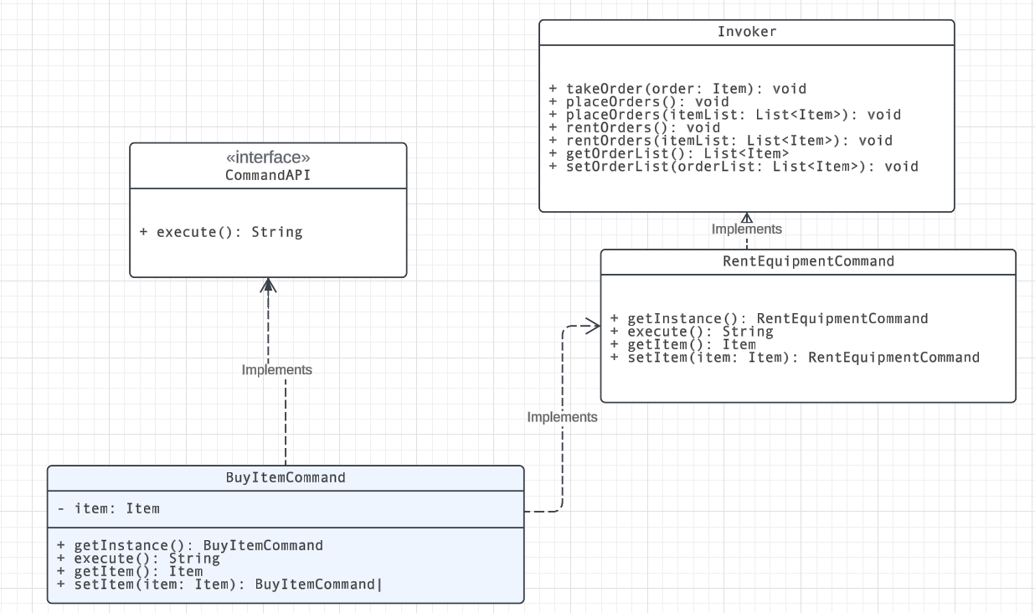
UML – Command Pattern
The Invoker (like your helper) keeps track of the list of things to buy or rent.
BuyItemCommand and RentEquipmentCommand are like specific instructions your helper follows when buying or renting things from the list.
Each command tells your helper what to do with each item on the list: whether to buy or rent it.

Slide 7
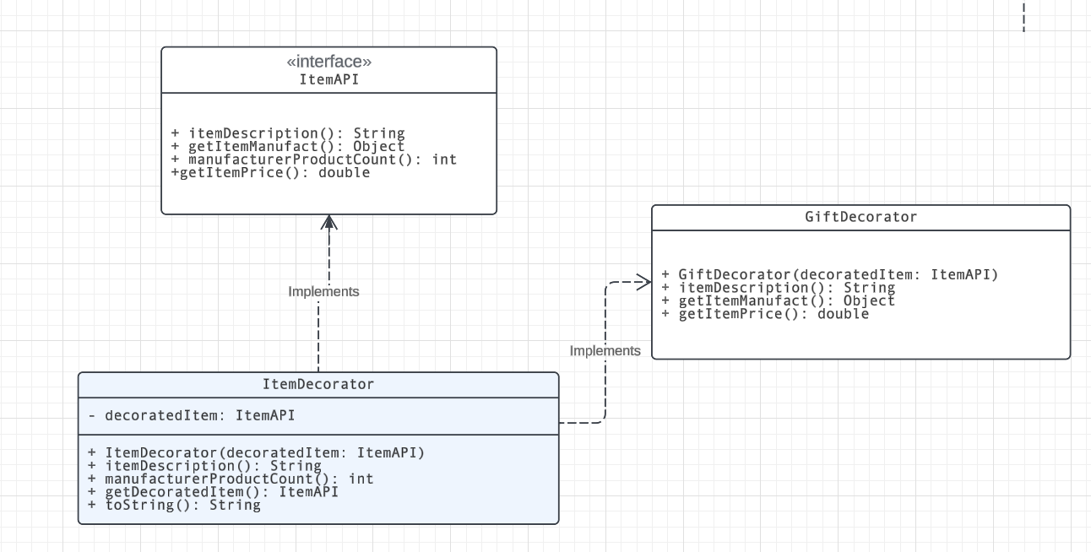
UML – DECORATOR Pattern
The Decorator pattern in the Store Management System adds extra features, like gift-wrapping, to items without changing their core functionality, much like adding decorative layers to a gift without altering its essence.

Slide 8
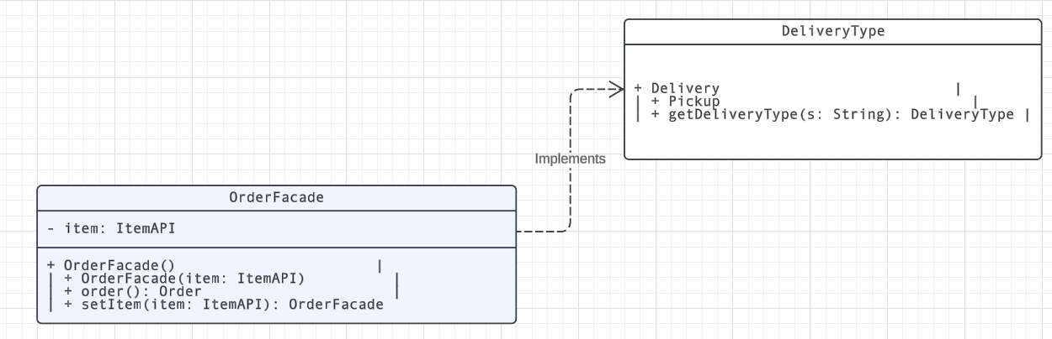
UML – Facade Pattern
The Facade pattern in the Store Management System simplifies the order process by providing a single interface (OrderFacade) to effortlessly add gift decoration (GiftDecorator) to items (ItemAPI) and include them in an order

Slide 9
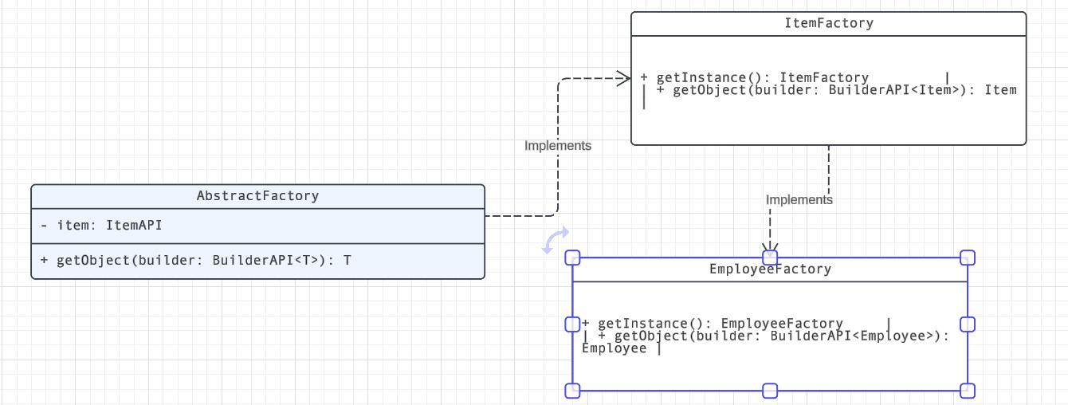
UML – Factory Pattern
The Factory pattern in the Store System sets up dedicated teams (EmployeeFactory and ItemFactory) following guidelines (AbstractFactory) to efficiently create employees and items using specific builders, ensuring systematic production and organization.

Slide 10
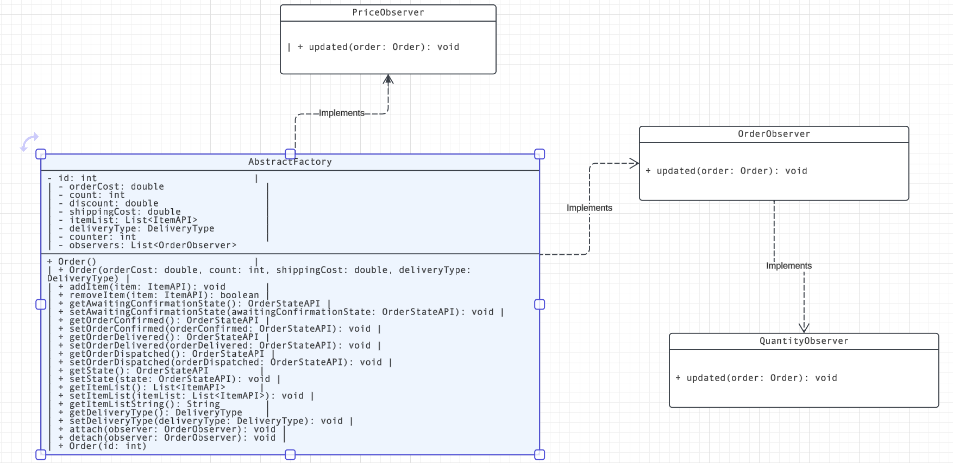
UML – Observer Pattern
The Observer pattern in the Store System works like a notification system: when an order changes, observers like the 'PriceObserver' and 'QuantityObserver' react, adjusting discounts and shipping costs based on specific conditions, keeping track of order updates.

Slide 11
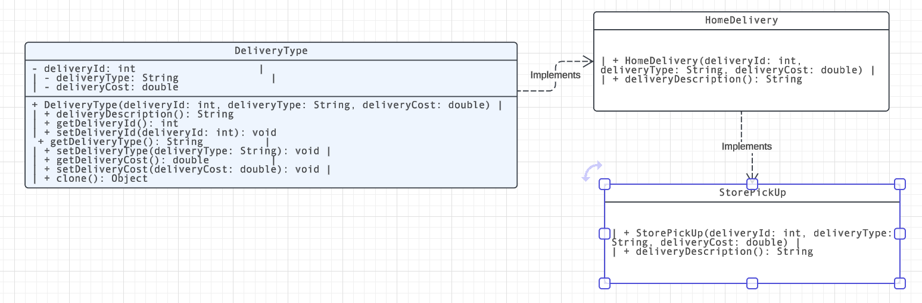
UML – Prototype Pattern
The Prototype pattern in the Store System is like a blueprint (DeliveryType) that allows creating different delivery types (HomeDelivery, StorePickUp) with their own details (descriptions) based on the blueprint. These types can be copied (cloned) while maintaining their individual characteristics.

Slide 12
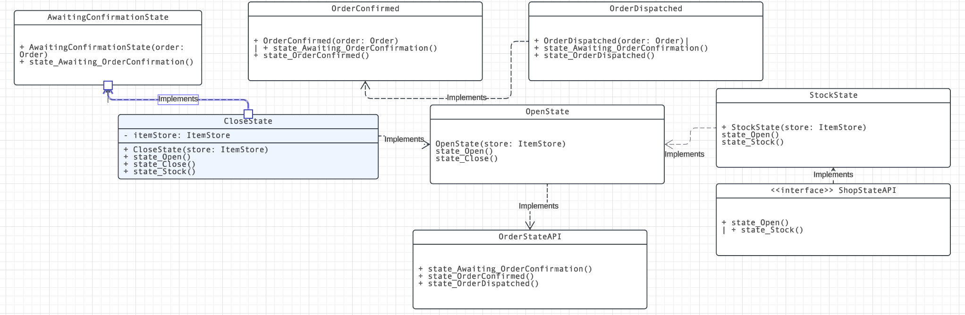
UML – State Pattern
The UML diagram illustrates different states for orders (such as awaiting confirmation, confirmed, dispatched, delivered) and shop status (like open, closed, or stocked) in the Store Management System, each with specific actions related to orders or shop operations.

Slide 13
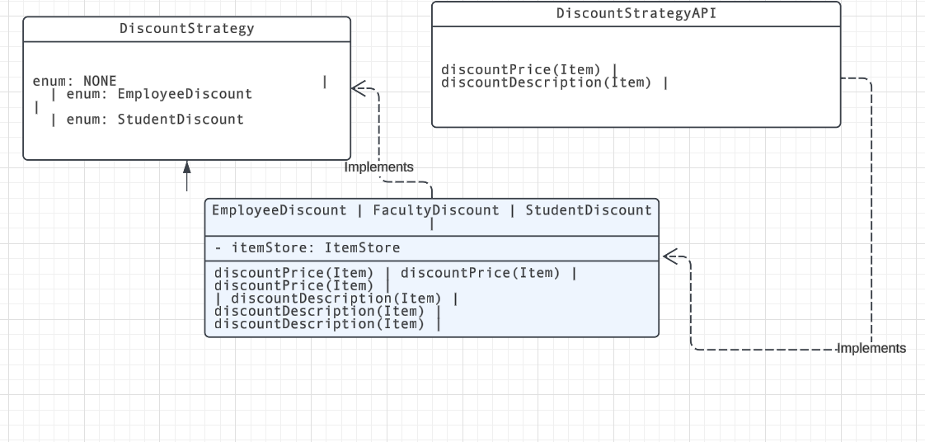
UML – strategy Pattern
The Strategy Pattern allows different discount strategies (Employee, Faculty, Student) to be selected dynamically for items, separating discount calculation methods into individual classes for easy swapping and reusability.

Slide 14
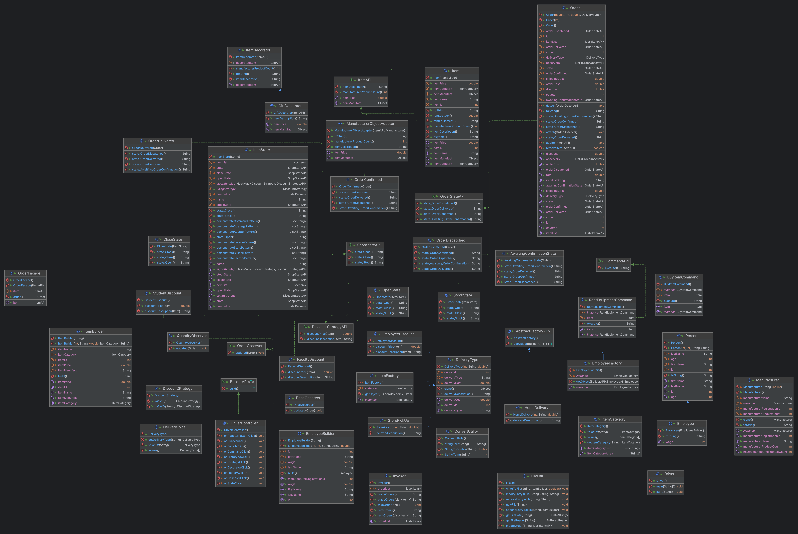
Class diagram

Slide 15
Future Enhancements
Sending notifications to all buyers
Enhanced user interface
Enhanced security measures
Accepting online payments
Real time chat systems for cliets

Slide 16

Contributors
Anouksha Kolige Sreemurthy
Anshul Tarun Sharma
Arpita Rai
Jahnavi Gangarapu
Krishnna Sarrdah

Slide 17

Thank you

